Slide 1
Welcome! Please seat yourself on one of the 5 tables. 6 kids per table. There are 5 teams: red, yellow, green, blue, and black.

Slide 2
Squishy Circuits INSPIRED BY http://courseweb.stthomas.edu/apthomas/SquishyCircuits/
Pavi Bhatter
Notes:
Good afternoon everyone. Welcome to the Squishy Circuit workshop! My name is Pavi Bhatter and I am a highschooler at Mission San Jose HS in Fremont. Who here has ever played with playdough? What are some things you have made with playdough?
Imagine if you could light up all those playdough figures with lights. That is exactly what we will be doing today!

Slide 3
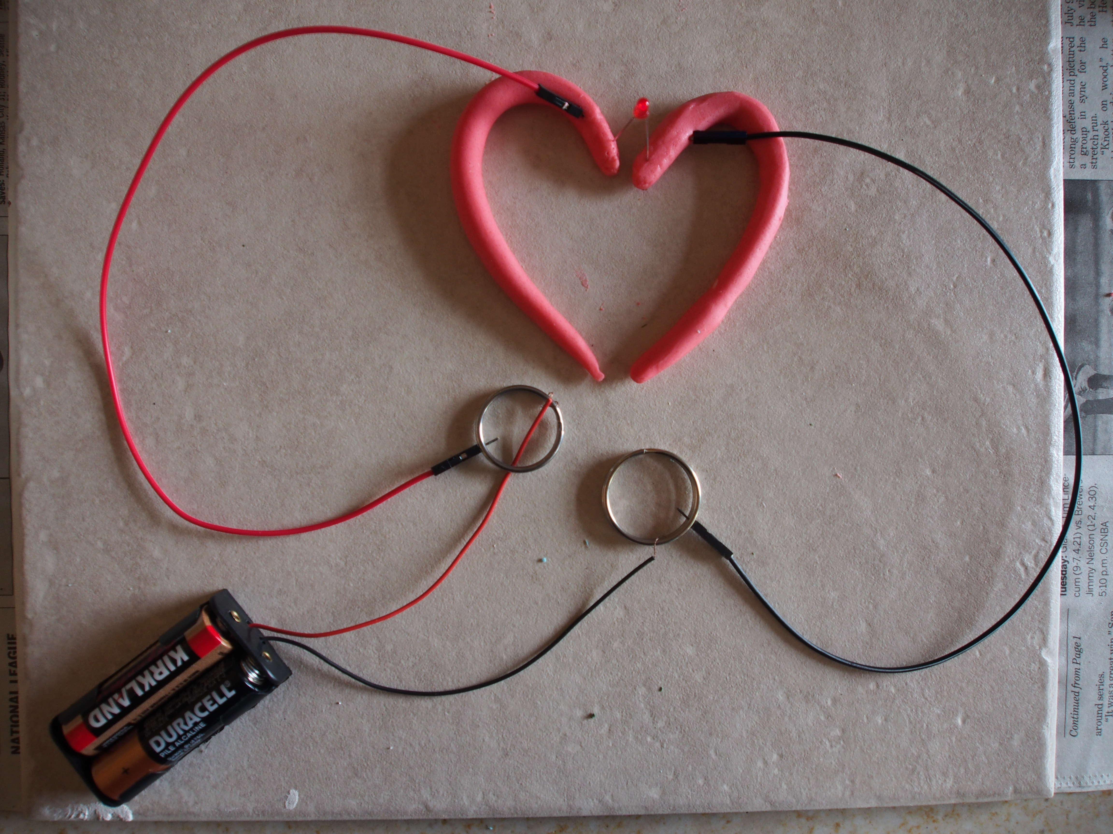
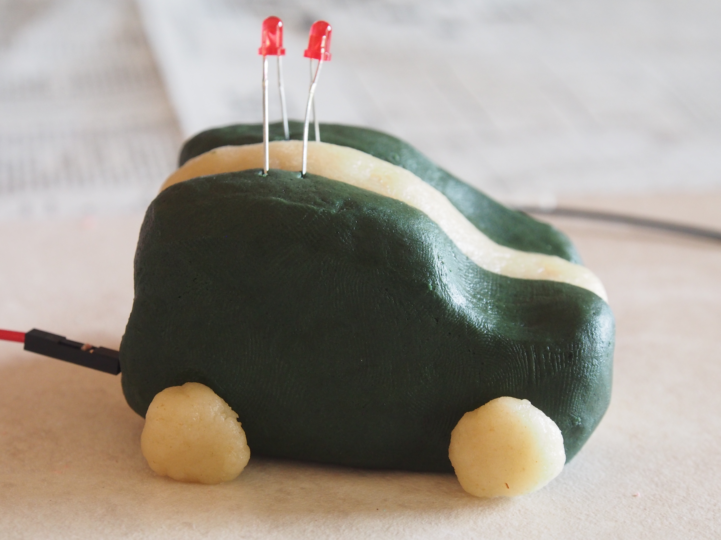
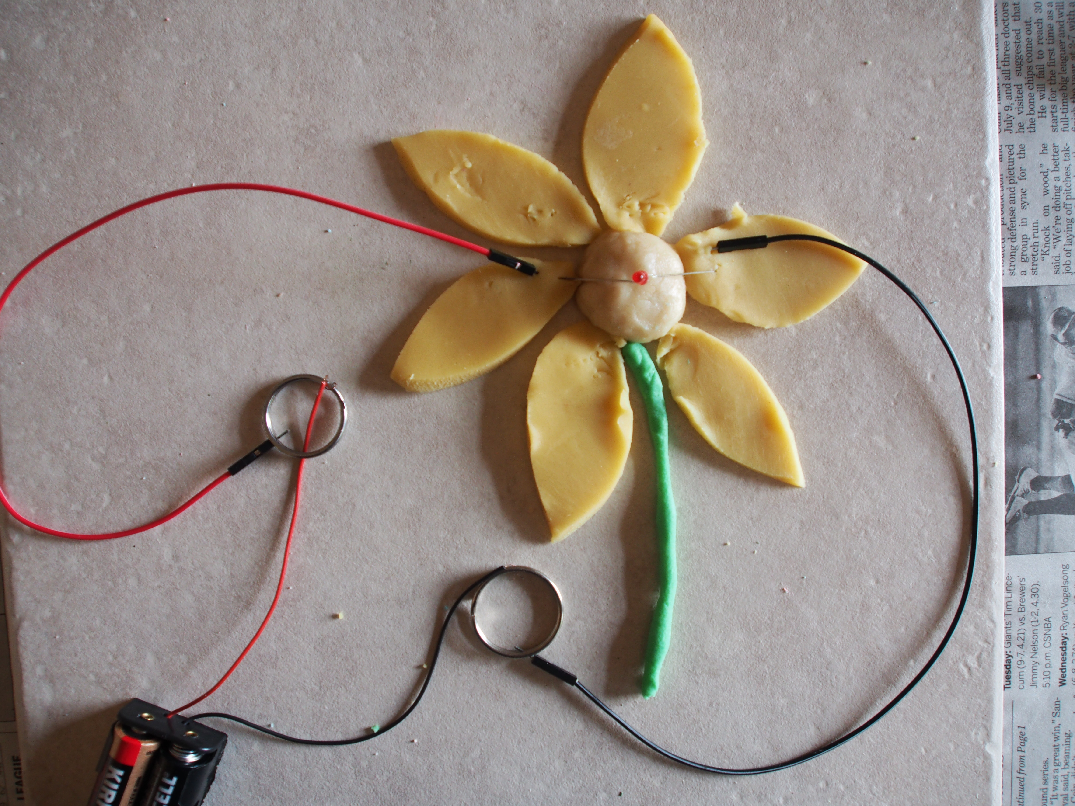
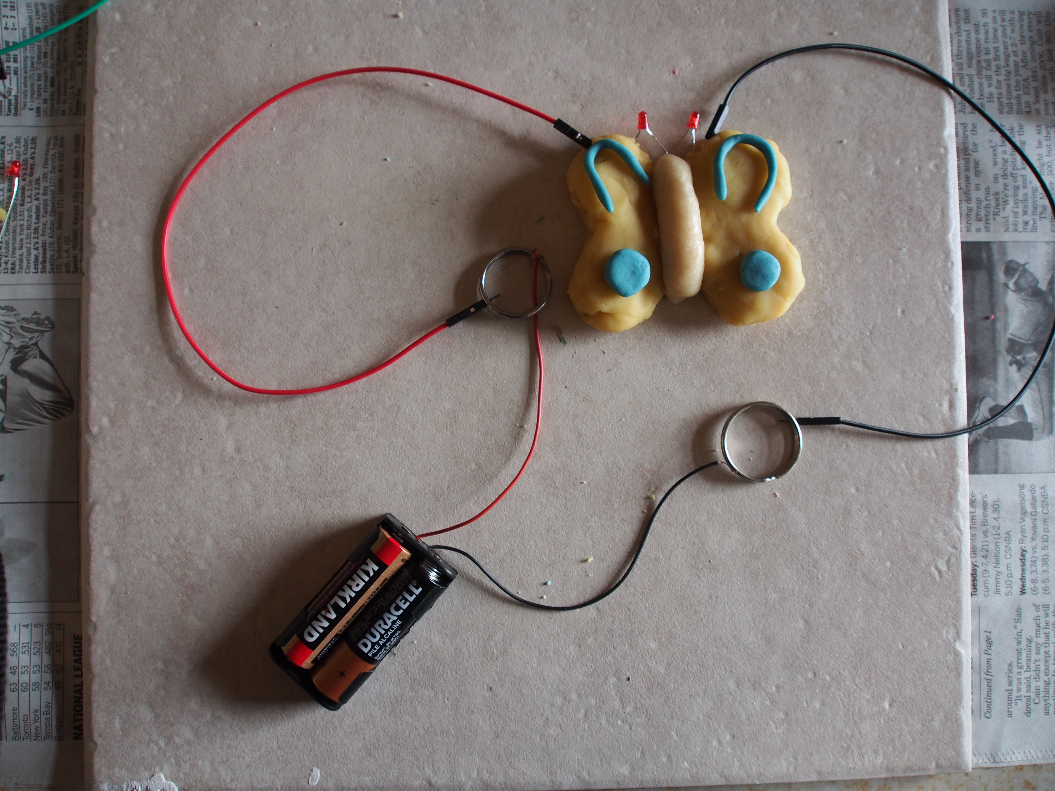
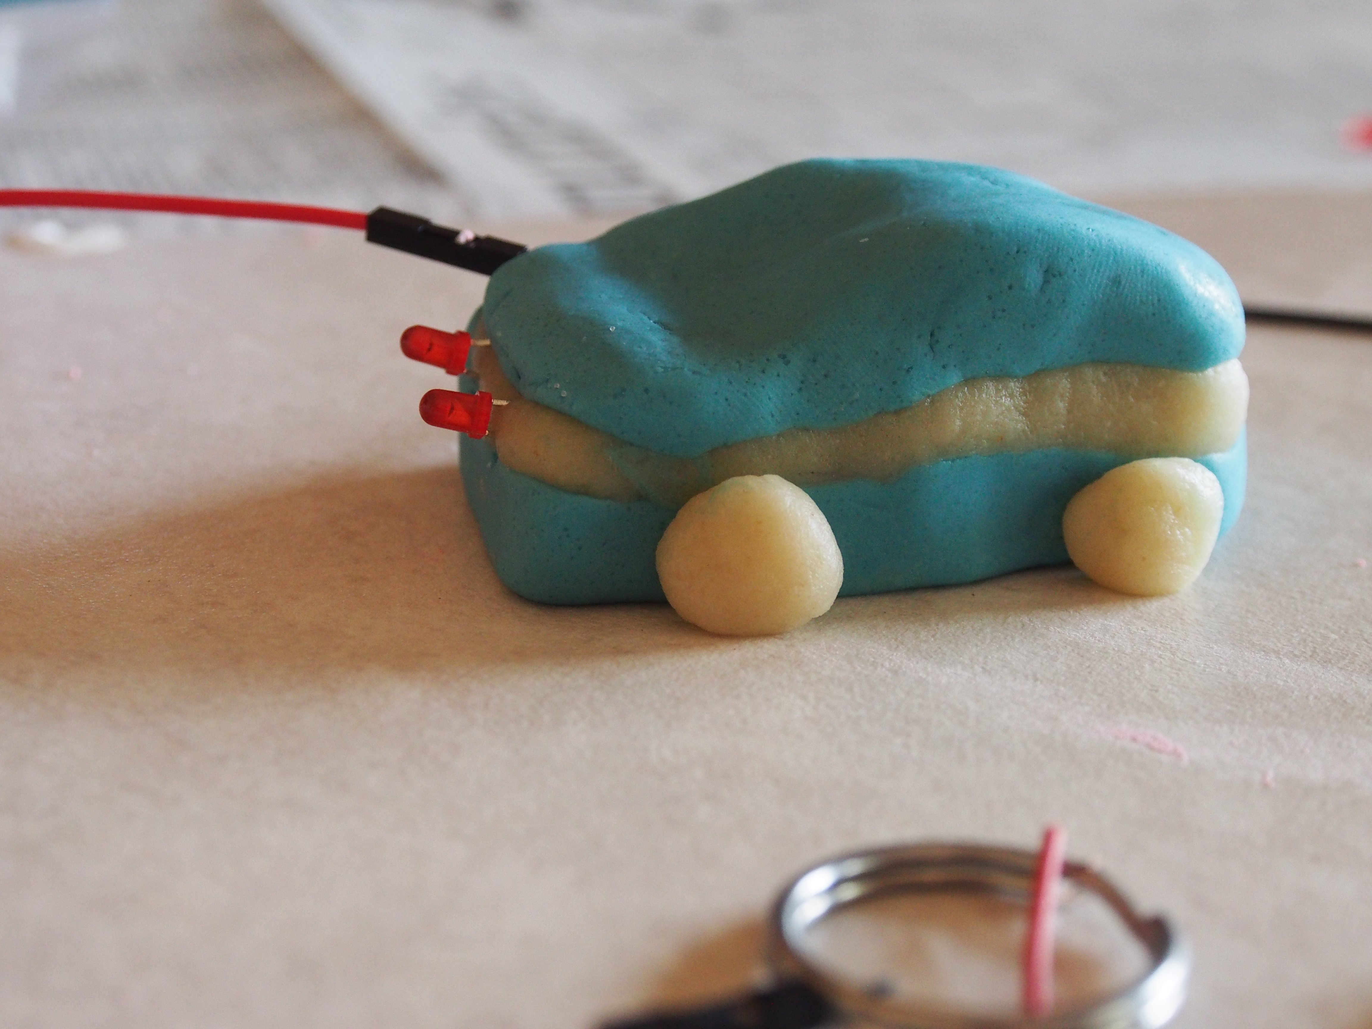
What are we going to do today?
Notes:
Today, we will be learning about circuits, electricity, series and parallel connections, and much more.
Also, we will be making some special dough to build our circuits with. Lastly, we will combine science with art to create our squishy circuits. Here are some pictures of examples of some cool things we will be making today! There is the heart, a police car, a flower, a butterfly, and a car. These are just some examples, but it’s up to YOUR imagination what you want to build!
Here I have made a heart shape out of playdough that I have lit up with a little light. How does this work? Can anyone guess?

Slide 4
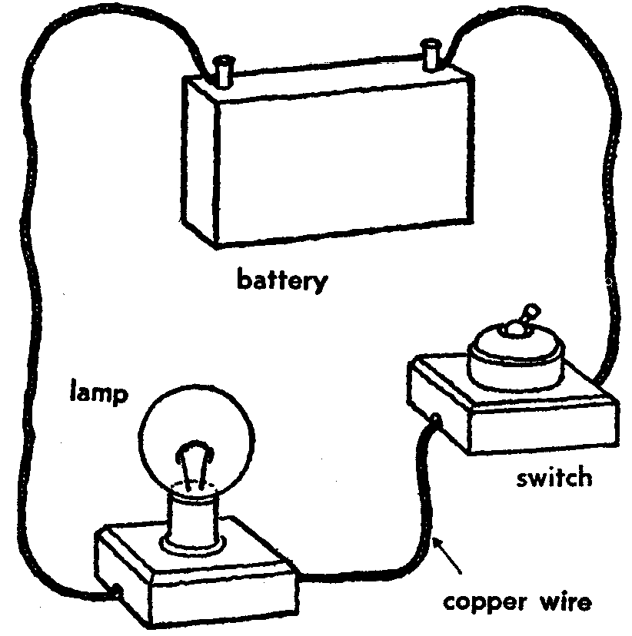
What is a Circuit?
> A circular path through which current can flow
> Needs a battery or source of energy that can make the current flow through it
> Something interesting like a LED, which does something when current flows.
Notes:
This here is a circuit I have built with playdough. A circuit is a…
Circular path through which current can flow
Needs a battery or source of energy that can make the current flow through it
Needs something interesting like a LED, which does something when current flows
Here the LED lights up!

Slide 5
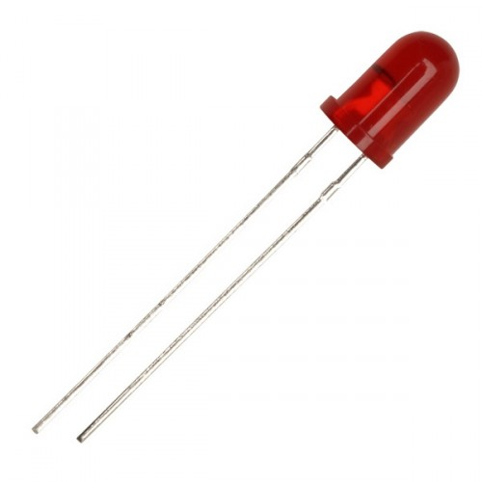
I am L-E-D
Light-Emitting-Diode
> A LED is a very small light, often colored (white / red / yellow / green)
> Each LED has two legs ... a short and a long
> Long is the PLUS (+) (positive pole)
> Short is the NEGATIVE (-) (negative pole)
> It glows when current flows
> It can handle only small amount of current
Notes:
In this circuit there are many components. This light over here, that is lighting up the heart, is called a LED.
A LED is a very small light, often colored
Each LED has two legs… a short and long
Long is the plus, positive pole
Short is the negative, negative pole
A LED glows when current flows
Can only handle a small amount of current

Slide 6
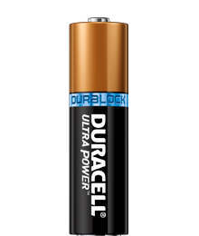
I am Battery
+
> Stores energy
> Converts stored chemical energy into electrical energy
> Batteries provide portable, convenient sources of energy for powering devices without using electrical outlets
>We will be using 1.5 Volt AA batteries. Everyone will get 4 batteries, for a total of 6 Volts
-
Notes:
How many of you have used batteries before?
Every circuit needs some source of energy
A battery stores energy
Converts stored chemical energy into electrical energy
Batteries provide portable, convenient sources of energy for powering devices without using electrical outlets.
We will be using 1.5 Volt AA batteries
Everyone will get 4 batteries, for a total of 6 Volts
- Batteries have a plus and minus end. When you attach them to your battery holder, make sure you match the positive side of the battery with the side of the battery holder labeled plus and vice versa for the negative end of the battery. The spring end of the battery holder ALWAYS goes with the negative side of the battery!

Slide 7
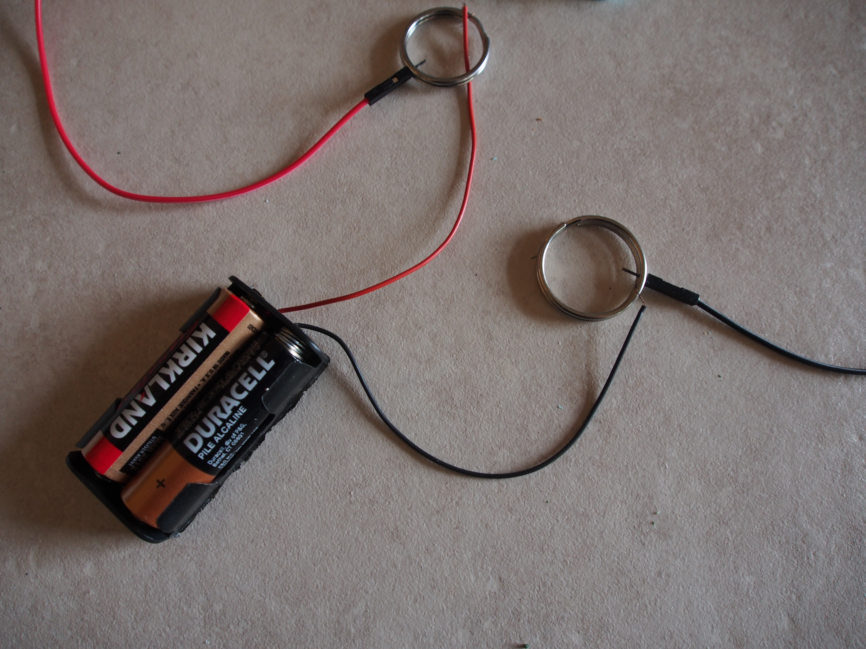
Wires – Negative and Positive
A RED wire connected to the battery means it is POSITIVE (+).
A BLACK wire connected to the battery means it is NEGATIVE (-).
Notes:
If you look at this battery holder, there is a red and black wire connected to it.
The red wired connected to a battery is usually code for being connected to the positive end of the battery.
The black wire connected to a battery is usually code for being connected to the negative end of the battery.

Slide 8
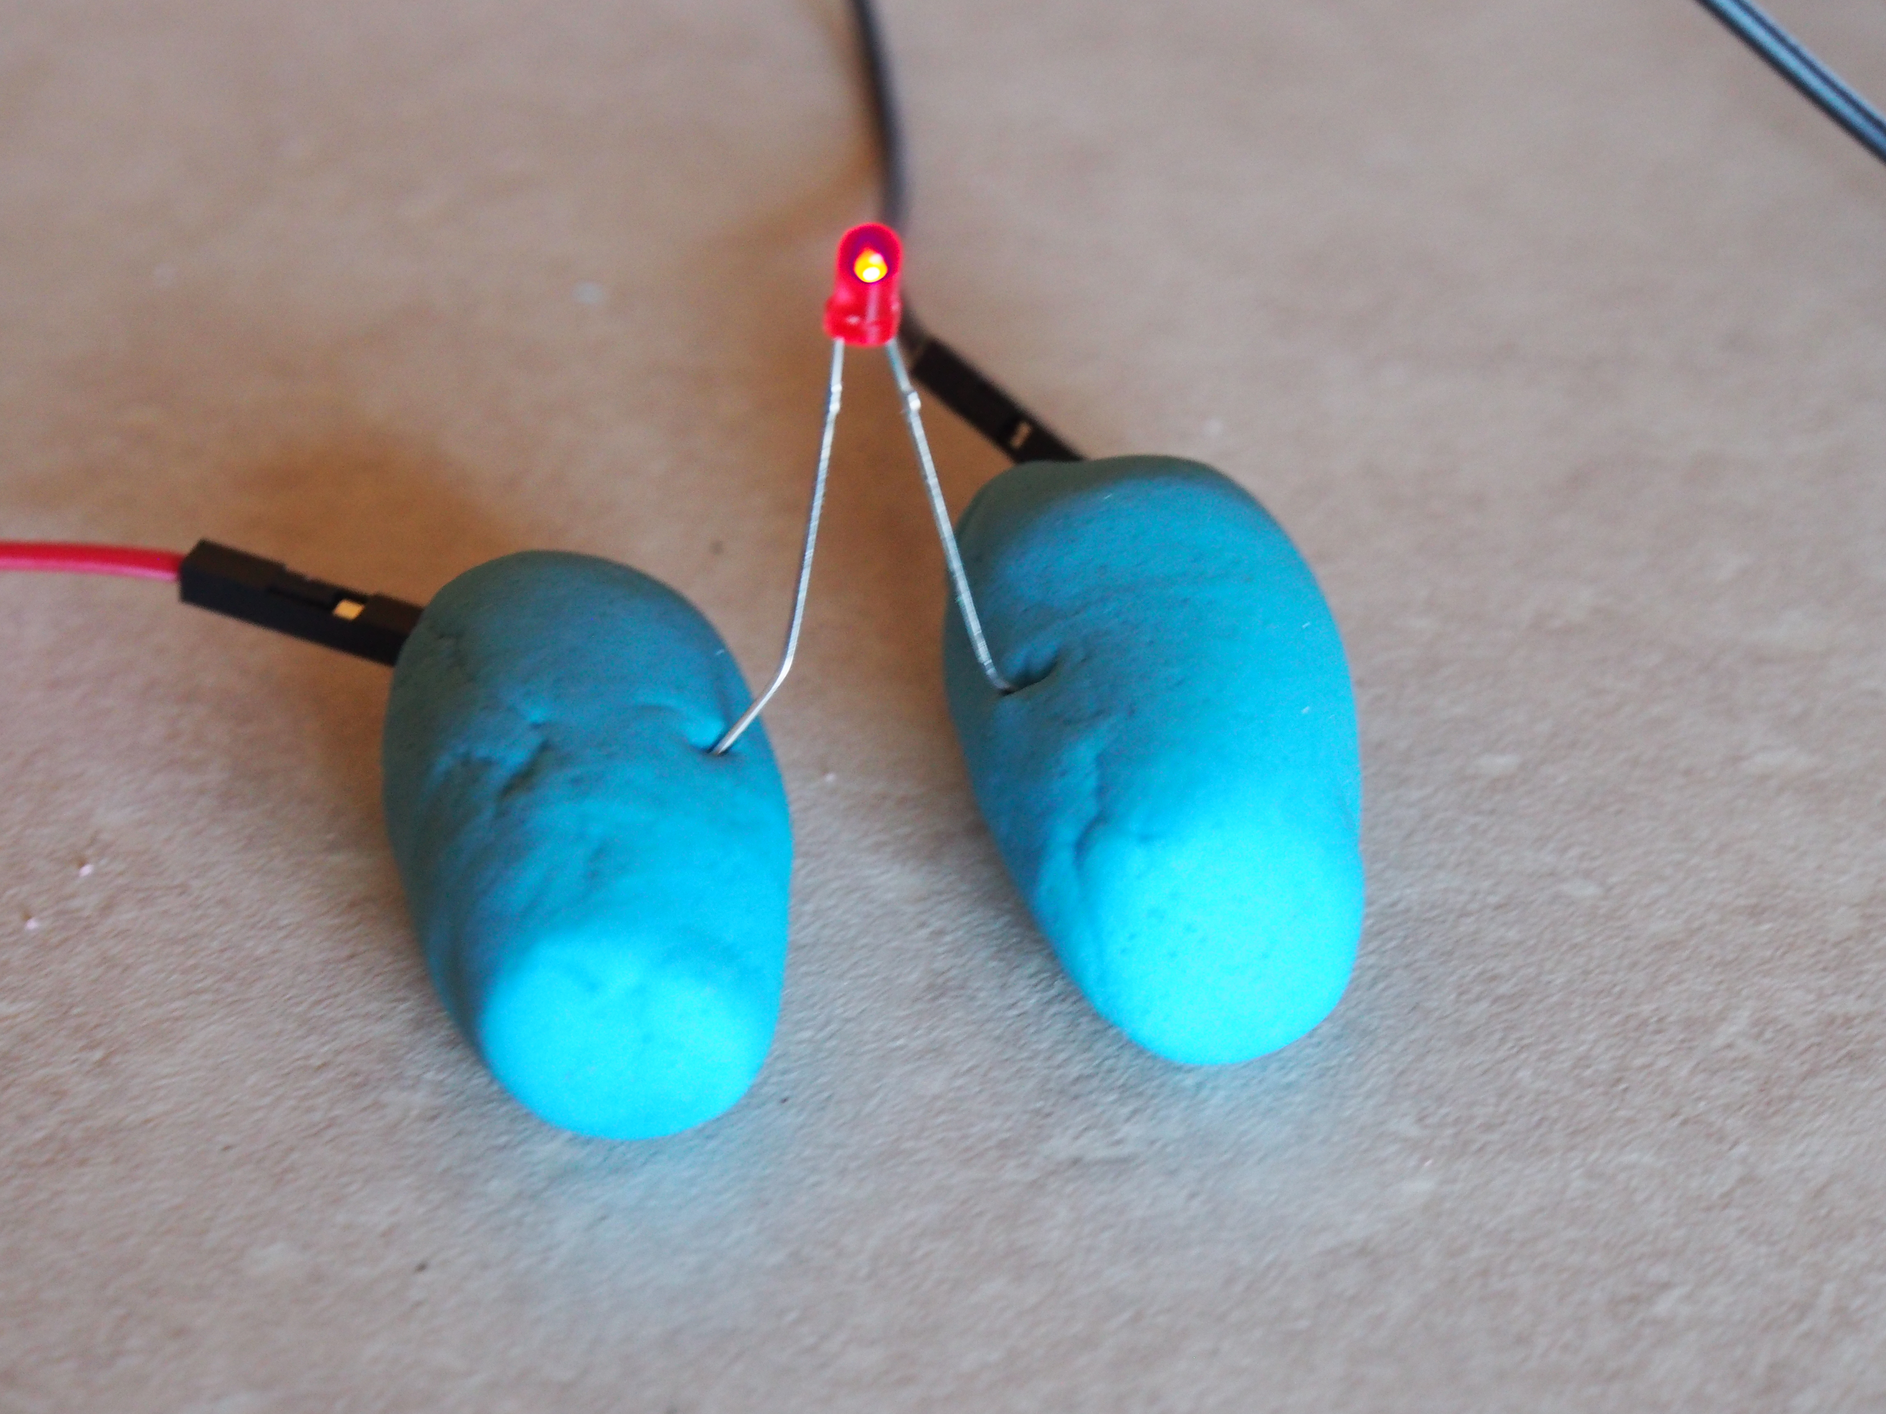
Long LED leg…POSITIVE (+) pole
Short LED leg…NEGATIVE (-) pole
POSITIVE (+) red wire.
NEGATIVE (-) black wire.
Notes:
Earlier I talked about how a LED has a short and long leg.
The wire connected to the positive side of the battery goes with the long leg of the LED.
The wire connected to the negative side of the battery goes with the short leg of the LED.
Just remember, the wire coming from the positive end of battery goes with the positive leg of the LED and the wire coming out from the negative end of the battery goes with the negative leg of the LED.

Slide 9
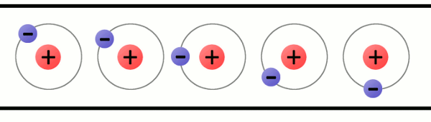
Current
> The flow of electrons through a conductive material or object
> It is the same at all points in a circular path
> Current is measured in amps
> You can think of this as the water flowing out of the tank through pipes
https://learn.sparkfun.com/tutorials/what-is-electricity/
Notes:
Can someone tell me what exactly is flowing through these wires? What is making the LED light up?
- Current is the flow of electrons though a conductive material or object.
- It is the same at all points in a circular and current is measured in amps.
- You can think of current as the water flowing out of the tank in pipes.

